Slide 1

DIGITAL PORTFOLIO !!
STUDENT NAME: YUVARANISRI S. M.
REGISTER NO AND NMID: 222403871/asumn293222403871
DEPARTMENT: COMPUTER SCIENCE
COLLEGE: VIDHYA SAGAR WOMENS COLLEGE

Slide 2
PROJECT TITLE
DIGITAL PORTFOLIO

Slide 3


AGENDA:
Problem Statement
Project Overview
End Users
Tools and Technologies
Portfolio design and Layout
Features and Functionality
Results and Screenshots
Conclusion
Github Link

Slide 4

PROBLEM STATEMENT
>> The gap or difficulty in the current system that your project solves.
“In today’s competitive world, talent often gets lost in plain resumes. Students with great projects fail to present them effectively, while recruiters waste time searching for the right candidate. Our project solves this communication gap.”

Slide 5



PROJECT OVERVIEW
The project is a Personal Portfolio Website developed in three stages: 1. Basic HTML structure (skeleton).
2. Styled version using CSS.
3. Interactive version using JavaScript.

Slide 6



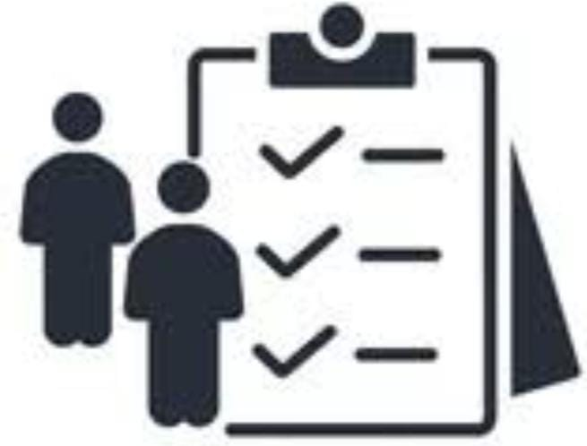

WHO ARE THE END USERS?
Students → To showcase their projects and skills. Fresher's / Job Seekers → To present their portfolio to recruiters. Employers / Recruiters → To quickly evaluate candidates. General Audience → To know more about the developer.

Slide 7


TOOLS AND TECHNIQUES
1.HTML5 → Structure of the website. 2.CSS3 → Styling, layout, responsive design. 3.JavaScript (ES6) → Interactivity, form validation, smooth scroll. 4.Code Pen → Development & online demo. 5.GitHub → Version control & hosting link.

Slide 8

POTFOLIO DESIGN AND LAYOUT
A portfolio showcases an individual’s skills, creativity, and achievements. Design layout is the structured arrangement of elements that makes the portfolio attractive and easy to navigate. A good layout ensures clarity, consistency, and a professional look
8

Slide 9

FEATURES AND FUNCTIONALITY
1.HTML Structure → Header, About, Skills, Projects, Contact, Footer. 2.CSS Styling → Colours, responsive layout, cards, sticky nav. 3.JavaScript → Smooth scroll, mobile menu toggle, form validation. 4.Responsive Design → Works on mobile, tablet & desktop. 5.Contact Section → Email, LinkedIn, phone with functional form.

Slide 10

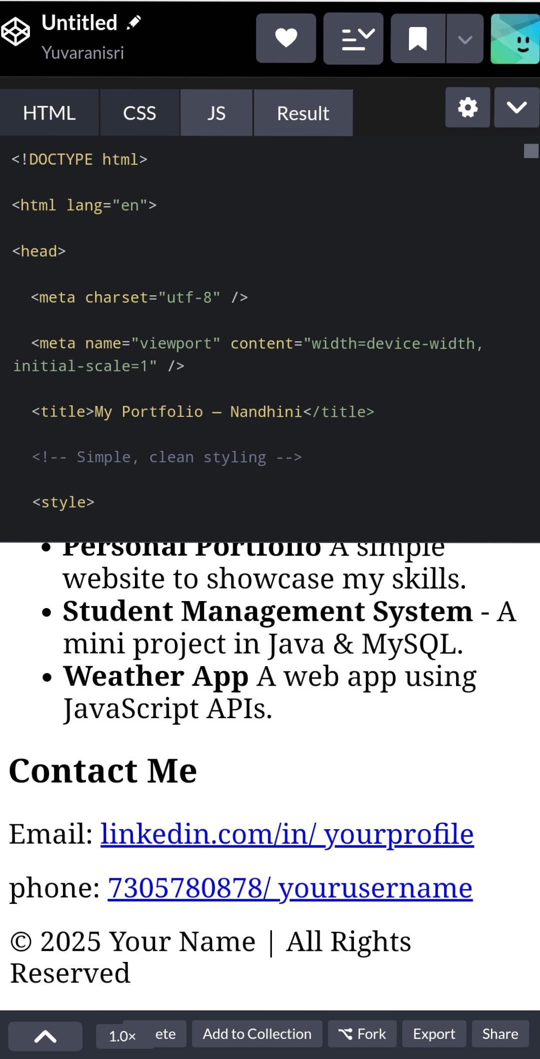
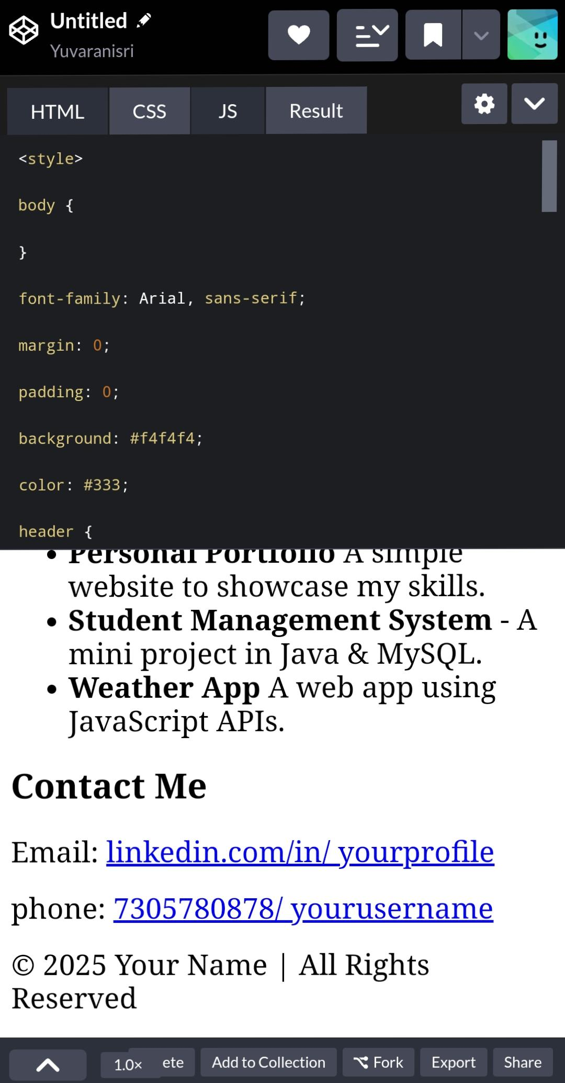
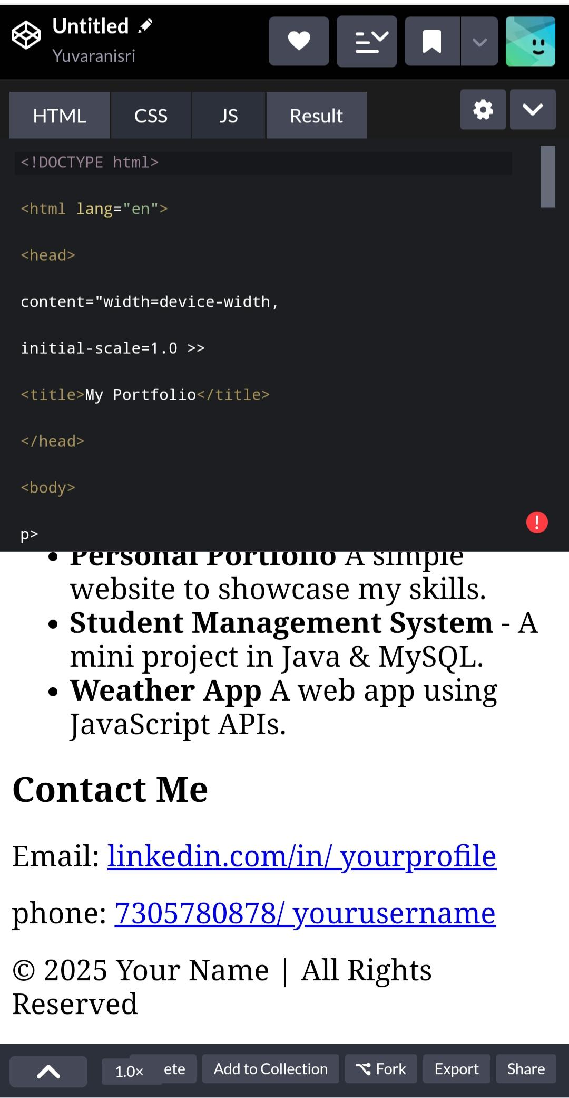
RESULTS AND SCREENSHOTS
10

Slide 11

ABOUT ME
I am yuvaranisri S. M. a B.Sc Computer Science student with an interest in IT and design. I enjoy creating digital content and learning new technologies. My goal is to build a career in IT while improving my creative and technical

Slide 12
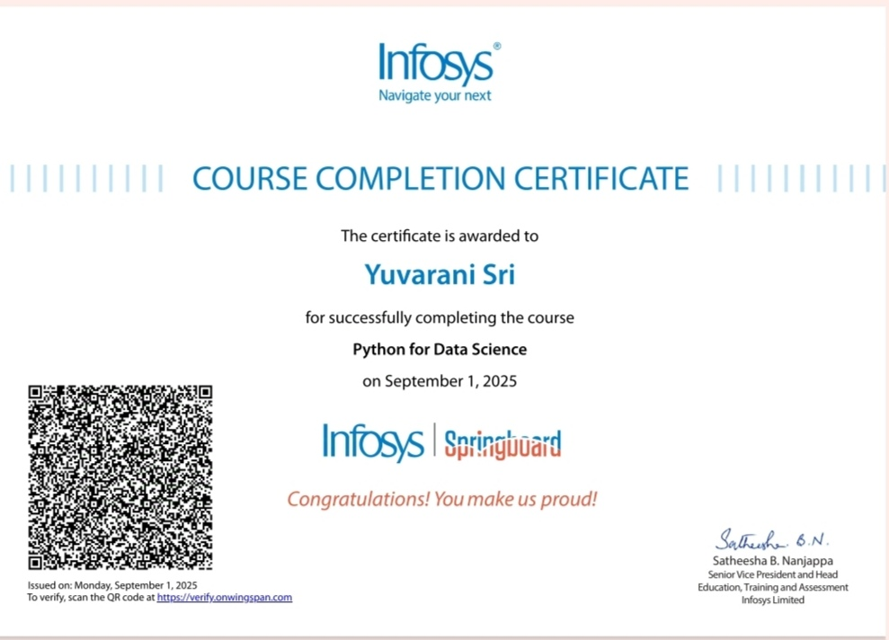


SKILLS
1.Certified in Python for Data Science by Infosys Springboard 2.Skilled in Python programming and data handling 3.Knowledge in data visualization, libraries, and analytics 4.Strong foundation in problem-solving and logical thinking

Slide 13



CONTACT
NM ID: asumn293222403871
EMAIL ID : yuvaranisri26@gmail.com
PHONE NO : 7305780878

Slide 14

CONCLUSION
A digital portfolio is more than just a collection of work—it is a professional representation of skills, creativity, and growth. It helps showcase achievements, reflect learning, and build a strong personal brand. By keeping it organized, updated, and visually appealing, a digital portfolio can open doors to academic, career, and personal opportunities.
THANKING YOU
14

